Slide 1

Reachability Score Calculation for Outbound Campaign Proof of Concept - Report Saikiran Gandham
07/25/2017
Saikiran Gandham | Ramyam Intelligence Lab
<number>
Notes:
<number>
Saikiran Gandham

Slide 2
Contents
Introduction
Objectives
Timelines
Data Modelling Approach
Approach
Individual Data Models
Introduction – Data Modelling
Business Use – Case
Data Selection Criteria
Receiver Operating Characteristics Curves
Ensemble Data Model
Introduction – Efficiency Parameters
Model Efficiency Parameters
Model-wise Observations / Metrics
Receiver Operating Characteristics Curves
Data Model Statistics
Scoring & Probability
Data Models & Attributes
Probability Scoring By Max Value
Lift Curve by Max Value
Probability Scoring By Mean Value
Lift Curve by Mean Value
Probability By Call Try
Probability Call Try’s - Hour / Day of Week
Conclusion
Further Actions
07/25/2017
Saikiran Gandham | Ramyam Intelligence Lab
<number>
Notes:
<number>
Saikiran Gandham

Slide 3
Introduction
07/25/2017
Saikiran Gandham | Ramyam Intelligence Lab
<number>
Notes:
<number>
Saikiran Gandham

Slide 4
Objective
Project Objective
Manage the entirety of a common project between Arvato and Ramyam
Create a common working process and project management tasks between the two actors
Business Objective
Create a acceptance score to predict the clients who will be reached to fetch information
Calculate probability of contacting Customer by Time / Day
Optimize cost of Future Campaigns
Define best mode of communication for sending campaigns
07/25/2017
Saikiran Gandham | Ramyam Intelligence Lab
<number>
Notes:
<number>
Saikiran Gandham

Slide 5
Timelines
Business Issues
Technical Framework
Study Base
Exploratory Analysis
Data Model Building
Data Model Report
Testing & Validation
Industrialization
2 Days
1 Day
2 Days
2 Days
2 Weeks, 3 Days
4 Days
TDB
TDB
01 June 2017
6 Weeks
20 July 2017
Process Steps
Use-Case Understanding
Business Requirement Document
ER Diagram
Solution Document
Exploratory Analysis Report
Data Pre-Processing
Model Creation
Final Recommendation
Go - Live
Data Modelling Report
Testing Results
Validation Report
Execution
07/25/2017
Saikiran Gandham | Ramyam Intelligence Lab
<number>
Notes:
<number>
Saikiran Gandham

Slide 6
Data Modelling Approach
07/25/2017
Saikiran Gandham | Ramyam Intelligence Lab
<number>
Notes:
<number>
Saikiran Gandham

Slide 7
Approach
Data
The Data sets used for building the suitable Data Model are:
Customer Data
Campaign Data
Data Model Testing
Data Models Used
4000 Contracts
C5- Decision Tree
Gradient Boosting Model - GBM
Ensemble Model
Output
Output
Prediction Score
Logistic Boosting - LB
80%
Training
20%
Testing
Random Forest - RF
Support Vector Machine - SVM
Remarks : Out of 20% Test Data, 15% is considered after Data Cleanup – 600 Contracts
07/25/2017
Saikiran Gandham | Ramyam Intelligence Lab
<number>
Notes:
<number>
Saikiran Gandham

Slide 8
Individual Data Models
07/25/2017
Saikiran Gandham | Ramyam Intelligence Lab
<number>
Notes:
<number>
Saikiran Gandham

Slide 9
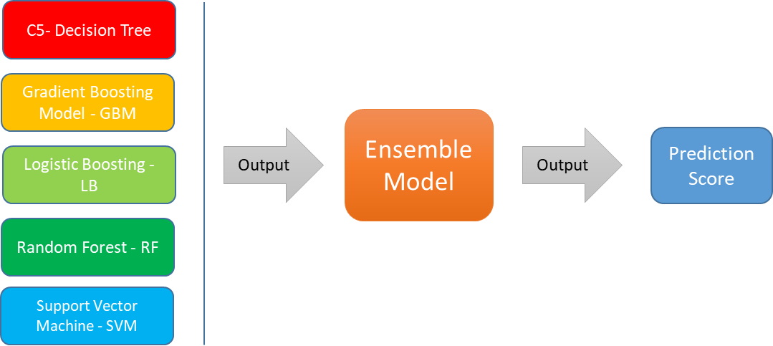
Introduction – Data Modelling
The Data Models used to evaluate the accuracy and efficiency to predict a reachability score are:
C5 : Decision Tree Algorithm
GBM : Gradient Boosting Model Algorithm
LB : Logistic Boosting Algorithm
RF : Random Forest Algorithm
SVM : Support Vector Machine Algorithm
07/25/2017
Saikiran Gandham | Ramyam Intelligence Lab
<number>
Notes:
<number>
Saikiran Gandham

Slide 10
Business Use - Case
Construct a Data Model to predict a reachability score.
Reachability score is the score calculated in order to obtain the customer information allowing optimization of the campaigns and to define the best target communication channel using the 2 Data Sets provided.
Datamart Data
Campaign Data
Data Points :
Field Names
campaign_result | other_phone_fiability
gender | phone_type
city_population | LastNameLen (Length of Last Name)
insurance_contrat_value | age_in_weeks
phone_number_used | doc_weeks (Age of contracts in Weeks)
07/25/2017
Saikiran Gandham | Ramyam Intelligence Lab
<number>
Notes:
<number>
Saikiran Gandham

Slide 11
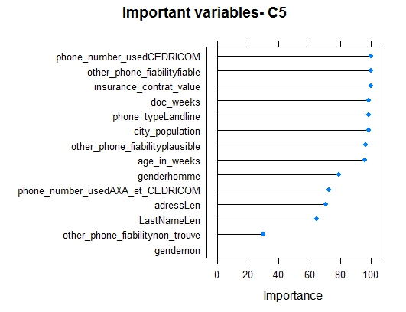
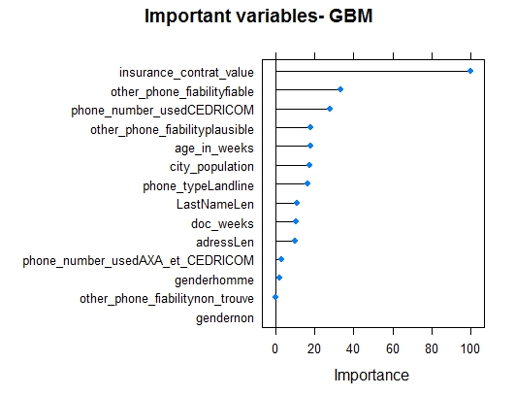
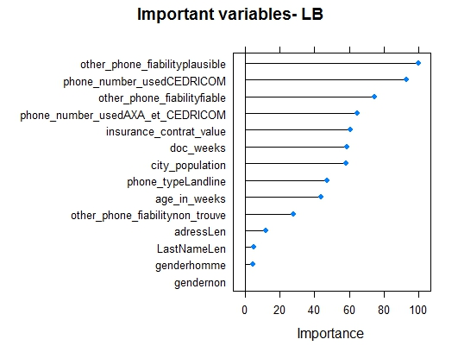
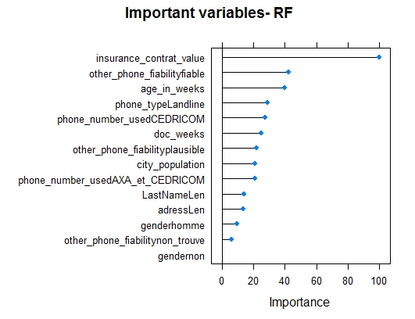
Data Selection Criteria
Variable Selection Criteria by Individual Models
Comments : Each Data Model analyzes the different parameters and rates the importance of the input variables. Based on the rating, Each algorithm generates efficiency parameters.
Remarks : As per the graphs, different parameters are important to different algorithms. Based on the algorithms characteristics, different data points are considered to calculate the efficiency and performance of the algorithm.
No data for
Support Vector Machine Algorithm - SVM
07/25/2017
Saikiran Gandham | Ramyam Intelligence Lab
<number>
Notes:
<number>
Saikiran Gandham

Slide 12
Data Selection Criteria
Variable Selection Ranking - Individual Models
Comments : As observed in the graphs, Each data attribute is allocated with a Rank. The rank indicates the importance of the attribute for the data model.
Remarks : Insurance Contract Value, Other Phone Fiability - Fiable are highly important data attributes required for any of the model for the calculation of probability score, while gender (both homme, non), Other Phone Fiability – Non Trouve are not of high importance with respect to the calculation of probability score
07/25/2017
Saikiran Gandham | Ramyam Intelligence Lab
<number>
Notes:
<number>
Saikiran Gandham

Slide 13
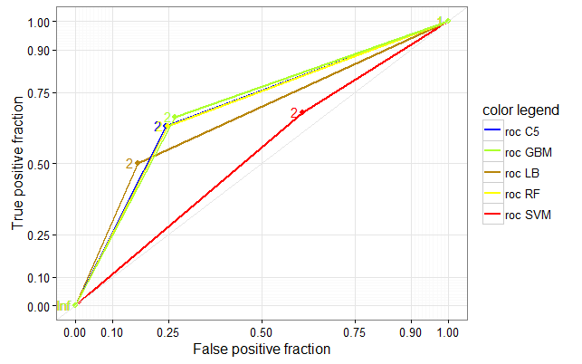
Receiver Operating Characteristics (ROC) Curves – Individual
ROC: Receiver Operating Characteristics (ROC) graphs are a useful technique for organizing classifiers and visualizing their performance.
Comments : These are the ROC curves for the first layer of our Algorithms for “OUI” Class.
The best tuning parameters are selected using the 10-fold cross validation method to arrive at the best ROC using ROC as a metric.
This approach is applied for each of the model i.e. C5, GBM, LB, RF, SVM.
07/25/2017
Saikiran Gandham | Ramyam Intelligence Lab
<number>
Notes:
<number>
Saikiran Gandham

Slide 14
Ensemble Data Model
07/25/2017
Saikiran Gandham | Ramyam Intelligence Lab
<number>
Notes:
<number>
Saikiran Gandham

Slide 15
Introduction – Efficiency Parameters
From each of the model, The following Model efficiency parameters are derived
Confusion Matrix: A confusion matrix is a summary of prediction results on a classification problem. The number of correct and incorrect predictions are summarized with count values and broken down by each class.
Sensitivity: Sensitivity is the proportion of actual positives which are correctly identified as positives by the classifier.
Specificity: Specificity relates to the classifier’s ability to identify negative results.
Accuracy: It is a scoring measure. It calculates the proportion of correctly classified instances.
Kappa: The Kappa statistic (or value) is a metric that compares an Observed Accuracy with an Expected Accuracy in a model and also within different models.
Pos Pred Value: The positive predictive value are the proportions of positive results in statistics.
The data is divided into 80 % Training data and 20 % Testing data. The models are trained by using k-Fold cross validation technique
07/25/2017
Saikiran Gandham | Ramyam Intelligence Lab
<number>
Notes:
<number>
Saikiran Gandham

Slide 16
Model Efficiency Parameters
Ensemble : C5 - Decision Tree
Ensemble : Gradient Boosting Model
Ensemble : Logistic Boosting
Ensemble : Random Forest
Confusion Matrix | Reference
Prediction | NON | OUI
NON | 384 | 94
OUI | 60 | 62
Confusion Matrix | Reference
Prediction | NON | OUI
NON | 360 | 118
OUI | 45 | 77
Confusion Matrix | Reference
Prediction | NON | OUI
NON | 384 | 94
OUI | 60 | 62
Confusion Matrix | Reference
Prediction | NON | OUI
NON | 361 | 117
OUI | 46 | 76
Accuracy | 0.743
95%CI | (0.706,0.778)
NoInformationRate | 0.74
P-Value[Acc>NIR] | 0.44738
Kappa | 0.282
Mcnemar'sTestP-Value | 0.00783
Sensitivity | 0.397
Specificity | 0.865
PosPredValue | 0.508
NegPredValue | 0.803
Prevalence | 0.26
DetectionRate | 0.103
DetectionPrevalence | 0.203
BalancedAccuracy | 0.631
'Positive'Class | OUI
Accuracy | 0.728
95%CI | (0.691,0.764)
NoInformationRate | 0.675
P-Value[Acc>NIR] | 0.00269
Kappa | 0.314
Mcnemar'sTestP-Value | 1.71E-08
Sensitivity | 0.395
Specificity | 0.889
PosPredValue | 0.631
NegPredValue | 0.753
Prevalence | 0.325
DetectionRate | 0.128
DetectionPrevalence | 0.203
BalancedAccuracy | 0.642
'Positive'Class | OUI
Accuracy | 0.743
95%CI | (0.706,0.778)
NoInformationRate | 0.74
P-Value[Acc>NIR] | 0.44738
Kappa | 0.282
Mcnemar'sTestP-Value | 0.00783
Sensitivity | 0.397
Specificity | 0.865
PosPredValue | 0.508
NegPredValue | 0.803
Prevalence | 0.26
DetectionRate | 0.103
DetectionPrevalence | 0.203
BalancedAccuracy | 0.631
'Positive'Class | OUI
Accuracy | 0.728
95%CI | (0.691,0.764)
NoInformationRate | 0.678
P-Value[Acc>NIR] | 0.00451
Kappa | 0.311
Mcnemar'sTestP-Value | 4.19E-08
Sensitivity | 0.394
Specificity | 0.887
PosPredValue | 0.623
NegPredValue | 0.755
Prevalence | 0.322
DetectionRate | 0.127
DetectionPrevalence | 0.203
BalancedAccuracy | 0.64
'Positive'Class | OUI
Note : SVM is not considered for Ensemble as the results were not as expected
07/25/2017
Saikiran Gandham | Ramyam Intelligence Lab
<number>
Notes:
<number>
Saikiran Gandham

Slide 17
Model-wise Observations / Metrics
Se
Sensitivity | Accuracy | Kappa | Positive Prediction Value
0.397 | 0.743 | 0.282 | 0.508
0.395 | 0.728 | 0.314 | 0.631
0.397 | 0.743 | 0.282 | 0.508
0.394 | 0.728 | 0.311 | 0.623
Ensemble : C5 Decision Tree
Ensemble : Gradient Boosting Model
Ensemble : Logistic Boosting
Ensemble : Random Forest
07/25/2017
Saikiran Gandham | Ramyam Intelligence Lab
<number>
Notes:
<number>
Saikiran Gandham

Slide 18
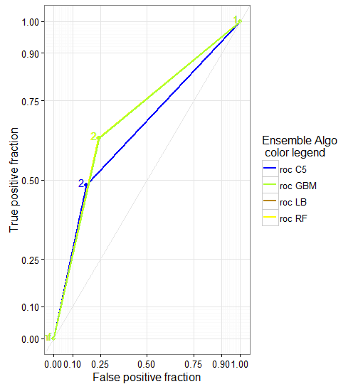
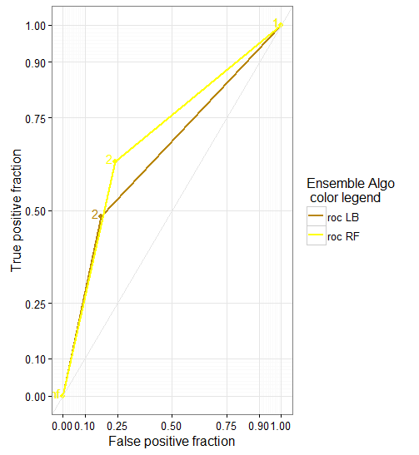
Receiver Operating Characteristics (ROC) Curves– Ensemble
Comments : These are the ROC curves for the top layer of our Algorithms for “OUI” Class.
The best tuning parameters are selected using the 10-fold cross validation method to arrive at the best ROC using ROC as a metric.
This approach is applied for each of the model i.e. C5, GBM, LB, RF
Note : Ensemble SVM is not considered because, the probability results were not as expected as compared to the metrics of Ensemble LB, Ensemble C5, Ensemble RF, Ensemble GBM
Two graphs are represented since the results of GBM with RF and C5 with LB are overlapping.
The overlapping is due to the similar efficiency parameters.
07/25/2017
Saikiran Gandham | Ramyam Intelligence Lab
<number>
Notes:
<number>
Saikiran Gandham

Slide 19
Data Model Statistics
Individual Models Statistics
Glossary:
OUI: Success
NON: Fail
Ensemble – C5
Ensemble – GBM
Ensemble - LB
Ensemble – RF
Comments : We are using the concept of Stacking to create ensemble model.
The Datamart Data is injected into each of the individual models, The output of all the models i.e. “OUI” probability (Level 0) is input to another algorithm (Level 1).
Remarks : We have found that ensemble models are very stable, and give slightly better performance than individual models. However as you will see, we are combining the outputs of individual + ensemble models to calculate the probability.
Note : Ensemble SVM is not considered because, the probability results were not as expected as compared to the metrics of Ensemble LB, Ensemble C5, Ensemble RF, Ensemble GBM as seen above.
Glossary :
C5 – Decision Tree Algorithm
GBM – Gradient Boosting Model Algorithm
LB – Logistic Boosting Algorithm
RF – Random Forest Algorithm
SVM – Support Vector Machine Algorithm
07/25/2017
Saikiran Gandham | Ramyam Intelligence Lab
<number>
Notes:
<number>
Saikiran Gandham

Slide 20
Scoring & Probability
07/25/2017
Saikiran Gandham | Ramyam Intelligence Lab
<number>
Notes:
<number>
Saikiran Gandham

Slide 21
Data Models & Attributes
Ensemble Modelling
Probability by Calls - Time
Probability by Calls – Day of Week
Reach Maximum Customers But Reduce Cost
Only Reach Customers with High Probability
Success Rate during Day Time
Success Rate during Evening Time
Success Rate during Weekday
Success Rate during Weekend
07/25/2017
Saikiran Gandham | Ramyam Intelligence Lab
<number>
Notes:
<number>
Saikiran Gandham

Slide 22
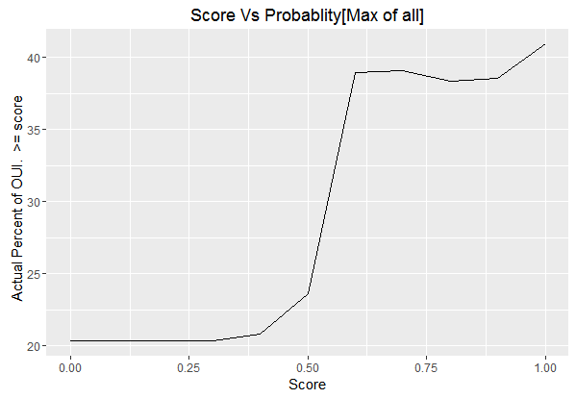
Probability Scoring By Max Value
above
Graph Depicting Score vs Actual Percent of “OUI”
Score Table vs Percentage
Probability Score by Max Value
Score | Percent | Ratio
0 | 20.33 | (OUI:122)/(TOTAL:600)
0.1 | 20.33 | (OUI:122)/(TOTAL:600)
0.2 | 20.33 | (OUI:122)/(TOTAL:600)
0.3 | 20.33 | (OUI:122)/(TOTAL:600)
0.4 | 20.8 | (OUI:115)/(TOTAL:553)
0.5 | 23.64 | (OUI:109)/(TOTAL:461)
0.6 | 38.63 | (OUI:90)/(TOTAL:233)
0.7 | 38.74 | (OUI:86)/(TOTAL:222)
0.8 | 38.38 | (OUI:76)/(TOTAL:198)
0.9 | 38.58 | (OUI:76)/(TOTAL:197)
1 | 40.96 | (OUI:68)/(TOTAL:166)
Actual Percentage ~ 38%
Score = 0.6, Ratio ~ 90 / 233
Comments : X - axis depicts Prediction Score, Y – axis depicts the Actual Percentage Ratio of OUI, Using different metrics, Max of the Probability score of all ensembles models is selected.
Remarks : The actual percentage of “OUI” increases as the probability ratio is increased. The actual percentage of “OUI” is low when the probability score is low.
Conclusion : 198 Contracts whose score is > 0.8 of which 76 Contracts were “OUI”.
Total “OUI” = 122 of 600, OUI % = 76/122 = 61%
Top Decile % = 198/600 = 33%
07/25/2017
Saikiran Gandham | Ramyam Intelligence Lab
<number>
Notes:
<number>
Saikiran Gandham

Slide 23
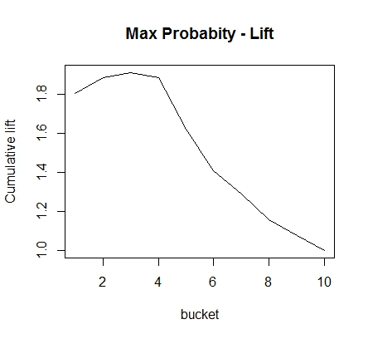
Lift Curve by Max Value
Graph Depicting Cumulative Lift
Cumulative Lift vs Decile
Comments: X – Axis depicts the Deciles. Y – Axis depicts the Cumulative lift of the probability of percentage of “OUI”
Remarks: The cumulate lift decreases as the decile value is increasing, The inference is that the probability percentage of “OUI” is high when the decile is less than 5.
Conclusion: According to the Max Value Model, If a top decile 40% of the total population is contacted, the percentage probability of having “OUI” is 75% in the total population.
Cumulative Lift = 75%
Population = 40%
07/25/2017
Saikiran Gandham | Ramyam Intelligence Lab
<number>
Notes:
<number>
Saikiran Gandham

Slide 24
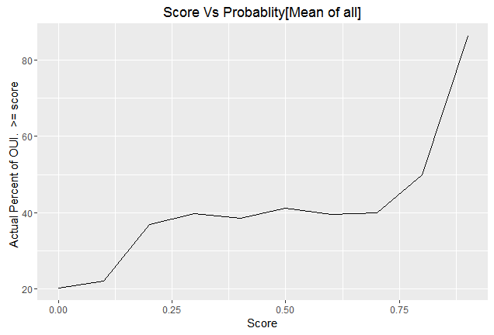
Probability Scoring By Mean Value
Graph Depicting Score vs Actual Percent of “OUI”
Score Table vs Percentage
Probability Score by Mean Value
Score | Percent | Ratio
0 | 20.33 | (OUI:122)/(TOTAL:600)
0.1 | 23.2 | (OUI:119)/(TOTAL:513)
0.2 | 37.1 | (OUI:92)/(TOTAL:248)
0.3 | 39.53 | (OUI:85)/(TOTAL:215)
0.4 | 38.89 | (OUI:77)/(TOTAL:198)
0.5 | 40.66 | (OUI:74)/(TOTAL:182)
0.6 | 39.62 | (OUI:63)/(TOTAL:159)
0.7 | 39.24 | (OUI:62)/(TOTAL:158)
0.8 | 48.62 | (OUI:53)/(TOTAL:109)
0.83 | 55.88 | (OUI:38)/(TOTAL:68)
0.9 | 72.41 | (OUI:21)/(TOTAL:29)
Actual Percentage ~ 55%
Score = 0.83, Ratio ~ 38 / 68
Comments : X - axis depicts Prediction Score, Y – axis depicts the Actual Percentage Ratio of OUI, Using different metrics, Mean of the Probability score of all ensembles models is selected.
Remarks : The actual percentage of “OUI” increases as the probability ratio is increased. But as visible in the graph, the percentage of “OUI” drops drastically when the Mean of Probability scores is considered.
Conclusion : 68 Contracts whose score is > 0.83 of which 38 Contracts i.e. were “OUI”.
Total “OUI” = 122 of 600, OUI % = 38/122 = 31%
Top Decile % = 68/600 = 11%
07/25/2017
Saikiran Gandham | Ramyam Intelligence Lab
<number>
Notes:
<number>
Saikiran Gandham

Slide 25
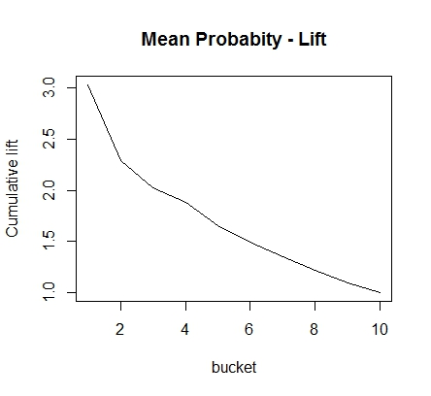
Lift Curve by Mean Value
Graph Depicting Cumulative Lift
Cumulative Lift Decile
Comments: X – Axis depicts the Deciles. Y – Axis depicts the Cumulative lift of the probability of percentage of “OUI”
Remarks: The cumulate lift decreases as the decile value is increasing, The inference is that the probability percentage of “OUI” is high when the decile is less than 4.
Conclusion: According to the Mean Value model, if top decile of 11% of the total population is contacted, the percentage probability of having “OUI” is 33% in the total population.
Cumulative Lift = 33%
Population = 11%
07/25/2017
Saikiran Gandham | Ramyam Intelligence Lab
<number>
Notes:
<number>
Saikiran Gandham

Slide 26
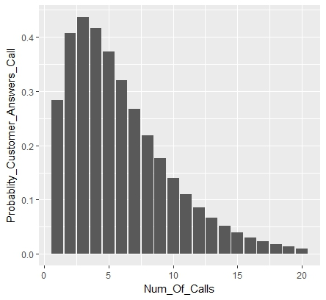
Probability By Call Try
Probability is calculated by using Binomial Trial Distribution.
This technique is used to calculate the probability of reaching all the persons irrespective of the campaign_result status initially. Based on the calculated score, the probability of reaching “OUI” is calculated for consecutive Call Try’s
Call Try’s | Probability | Call Try’s | Probability | Call Try’s | Probability | Call Try’s | Probability
1 | 0.2841 | 6 | 0.3205 | 11 | 0.1105 | 16 | 0.03021
2 | 0.4068 | 7 | 0.2677 | 12 | 0.08627 | 17 | 0.02298
3 | 0.4368 | 8 | 0.219 | 13 | 0.0669 | 18 | 0.01741
4 | 0.4169 | 9 | 0.1764 | 14 | 0.05158 | 19 | 0.01316
5 | 0.3731 | 10 | 0.1403 | 15 | 0.03956 | 20 | 0.009916
Comments: Number of Call try's Vs the probability of contacting the person using Binomial Trial Distribution.
Conclusion: After 4th or 5th call, the probability is decreasing , so recommendation is unless compelling reason, person should be contacted by other means.
07/25/2017
Saikiran Gandham | Ramyam Intelligence Lab
<number>
Notes:
<number>
Saikiran Gandham

Slide 27
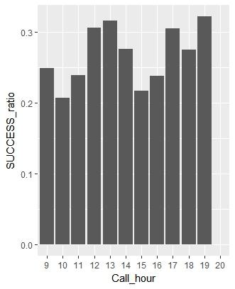
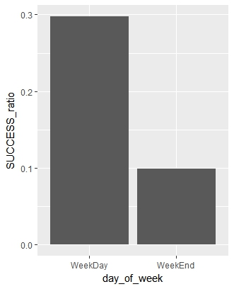
Probability Call Try’s - Hour / Day of Week
Call Try’s by Hour
Call Try’s by Day of Week
CALL_HOUR | FAIL | SUCCESS | SUCCESS_RATIO
9 | 202 | 67 | 0.2491
10 | 226 | 59 | 0.2070
11 | 232 | 73 | 0.2393
12 | 138 | 61 | 0.3065
13 | 158 | 73 | 0.3160
14 | 139 | 53 | 0.2760
15 | 220 | 61 | 0.2171
16 | 246 | 77 | 0.2384
17 | 173 | 76 | 0.3052
18 | 163 | 62 | 0.2756
19 | 166 | 79 | 0.3224
20 | 1 | 0 | 0.0000
DAY_OF_WEEK | FAIL | SUCCESS | SUCCESS_RATIO
WeekDay | 1637 | 694 | 0.29773
WeekEnd | 427 | 47 | 0.09916
Comments :
Success ratio is best between 11 am – 14 pm and 16 pm to 19 pm.
Success ratio is best on Weekdays against success ratio on Weekends.
Remarks: Probability score is calculated by Success call / total calls.
Conclusion: Probability calculations results per contract id gives almost equal probability for weekday vs Weekend and for all the call hours. So we can conclude that, as gender, place of living, age has no influence on the call hour or weekday vs weekend. However, as seen from the table, weekday has more success for everyone irrespective of any other parameter.
07/25/2017
Saikiran Gandham | Ramyam Intelligence Lab
<number>
Notes:
<number>
Saikiran Gandham

Slide 28
Conclusion
[Reach 90, Call 233 Contracts gives Probability 38.6%]
Comments
Comparison is drawn from both the models to arrive at the below results.
Results
Business Use case | Reach Maximum Customers but Reduce Cost | Only reach Customers with Max Probability
Max of all Models | Good [Reach 75% (90 of 122) Call 40%(233 of 600) Population], [Score : 0.6] | Reach 68 of 122, Call 166 of 600. At Best 40%
Mean of all Models | Reach 92 of 122, Call 248 of 600. At Best 37% | Good [Reach 31% {38 of 122} Call 11%{68 of 600} Population], [Score : 0.83]
Conclusion Data Modelling :
Max Probability Score from all the models approach is best approach because We want to reach maximum people with maximum probability.
Conclusion Call Try Probability :
Customers should be contacted during 11 am – 14 pm and 16 pm to 19 pm during Weekdays.
Total Test Data = 600
Total “OUI” = 122
07/25/2017
Saikiran Gandham | Ramyam Intelligence Lab
<number>
Notes:
<number>
Saikiran Gandham

Slide 29
Further Actions
Future Enhancements
Building of Contract Profiles for Customers based on Score.
Testing & Validation
Provide Test Data without Label (Campaign Result)
Results will be shared for Validation
Industrialization
Sharing of Data Model Parameters / Data Model Information
07/25/2017
Saikiran Gandham | Ramyam Intelligence Lab
<number>
Notes:
<number>
Saikiran Gandham

